Slide 1
Greeta
Automated Welcome Scenario
Team: Among Us

Slide 2
Greeta
Automated Welcome Scenario
Customer
Expectations
Humanizing Technology
Vehicle As a gadget
Relationship of the customer with the car is changing
Humanizing vehicles goes a long way in building trust in new technology
A vehicle is a gadget now!
Be the first to innovate!
Team: Among Us

Slide 3



Hello World! Let me Introduce myself… I am Mercedes!

Slide 4
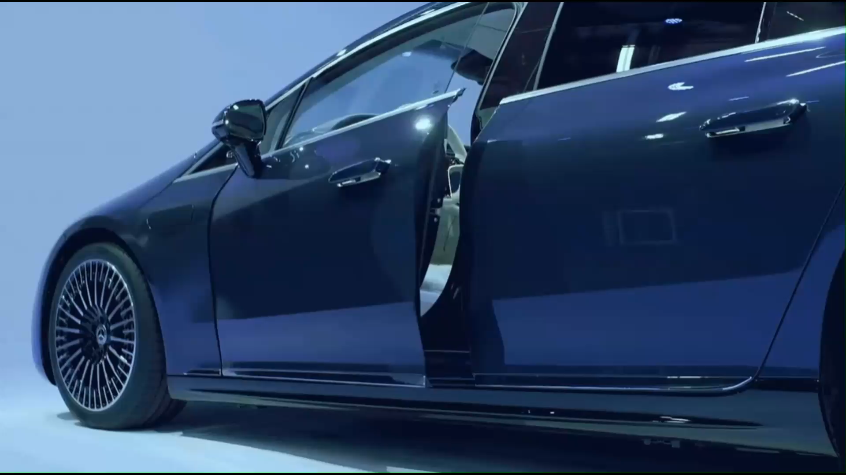
Recognize

Slide 5
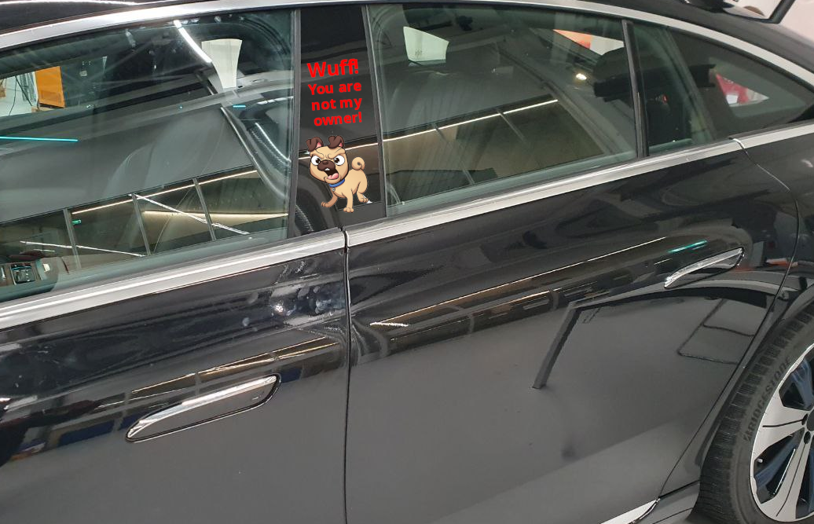
Recognize

Slide 6
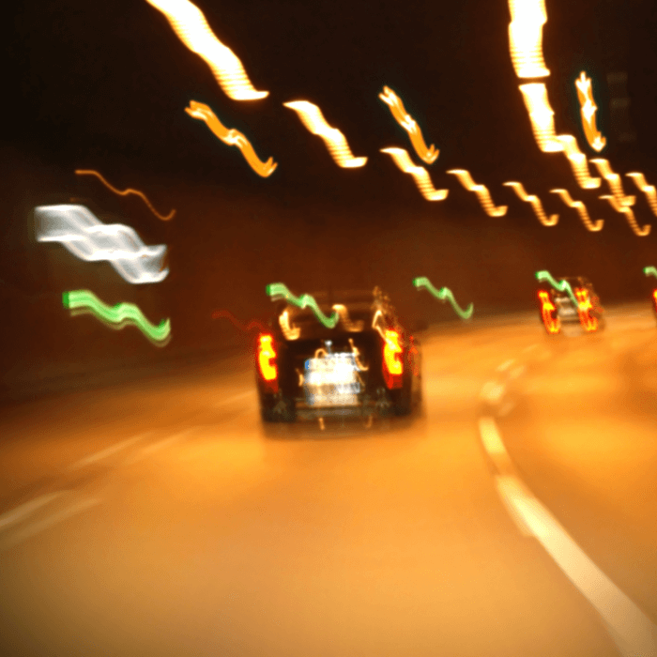
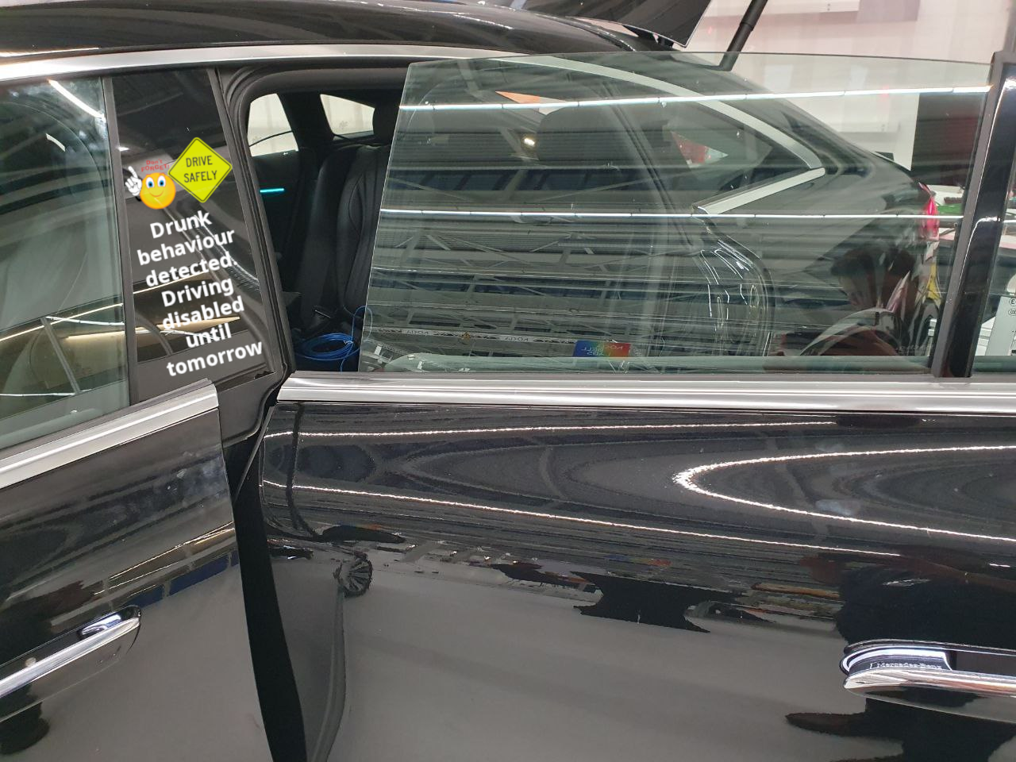
Recognize

Slide 7
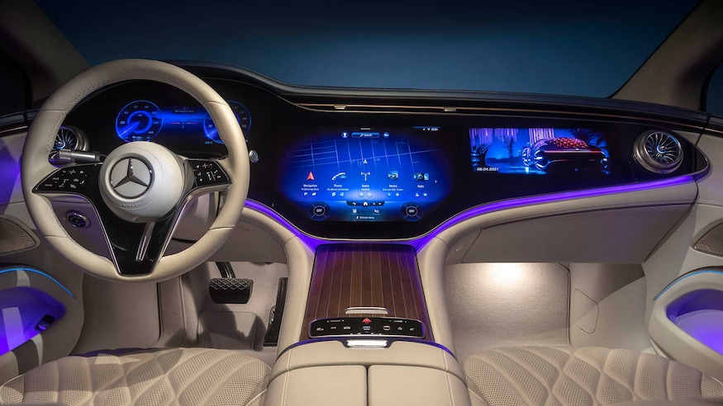
Greet

Slide 8

Personalize

Slide 9
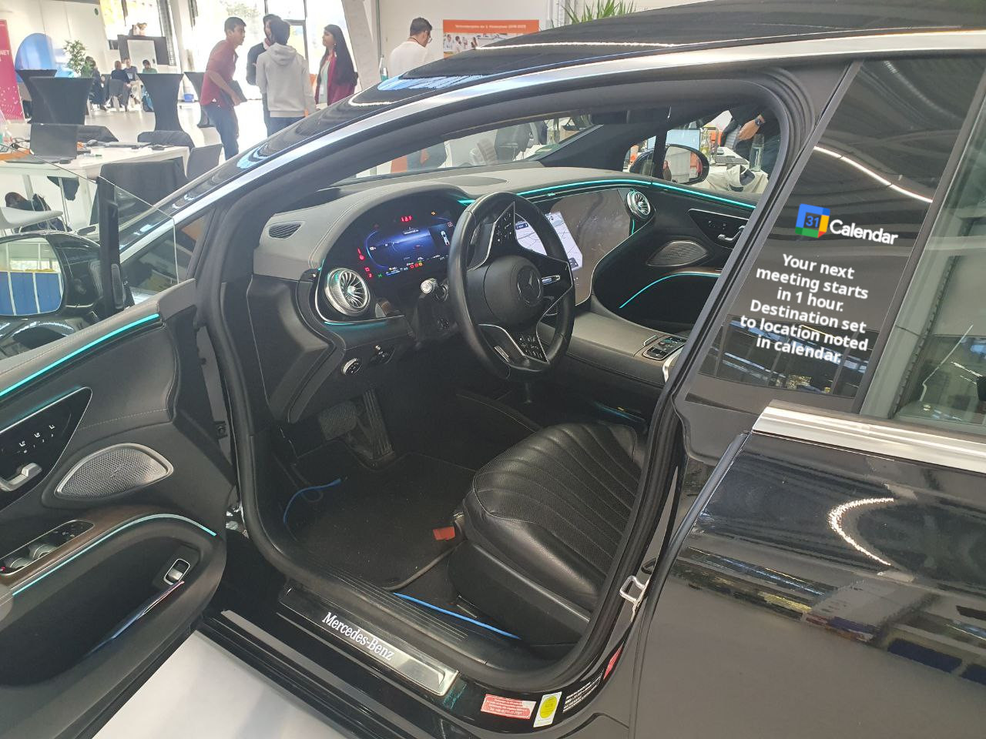


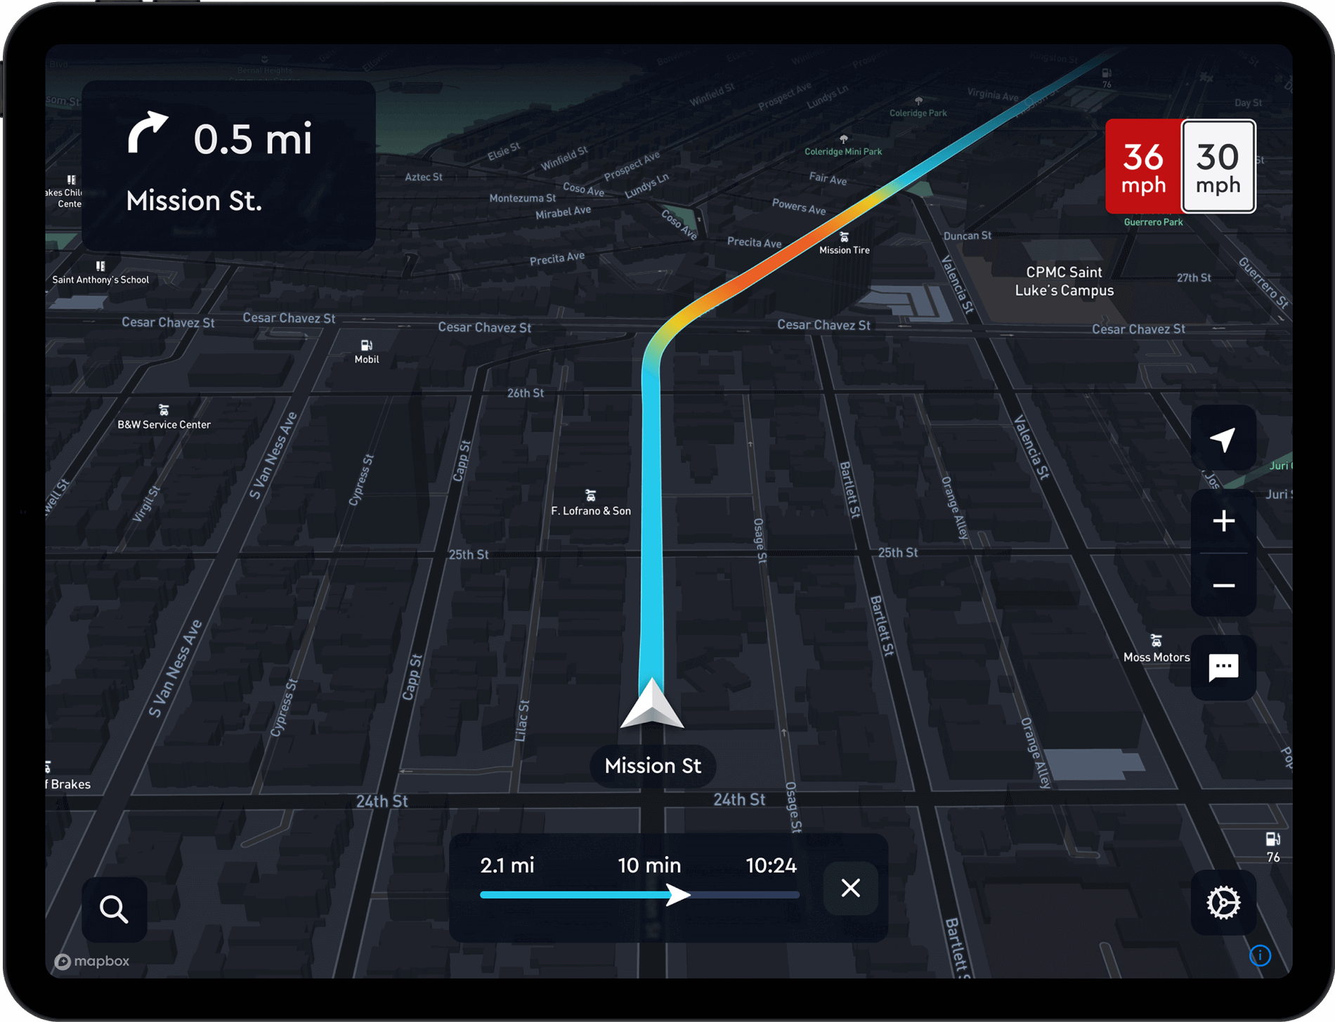
Personalize

Slide 10
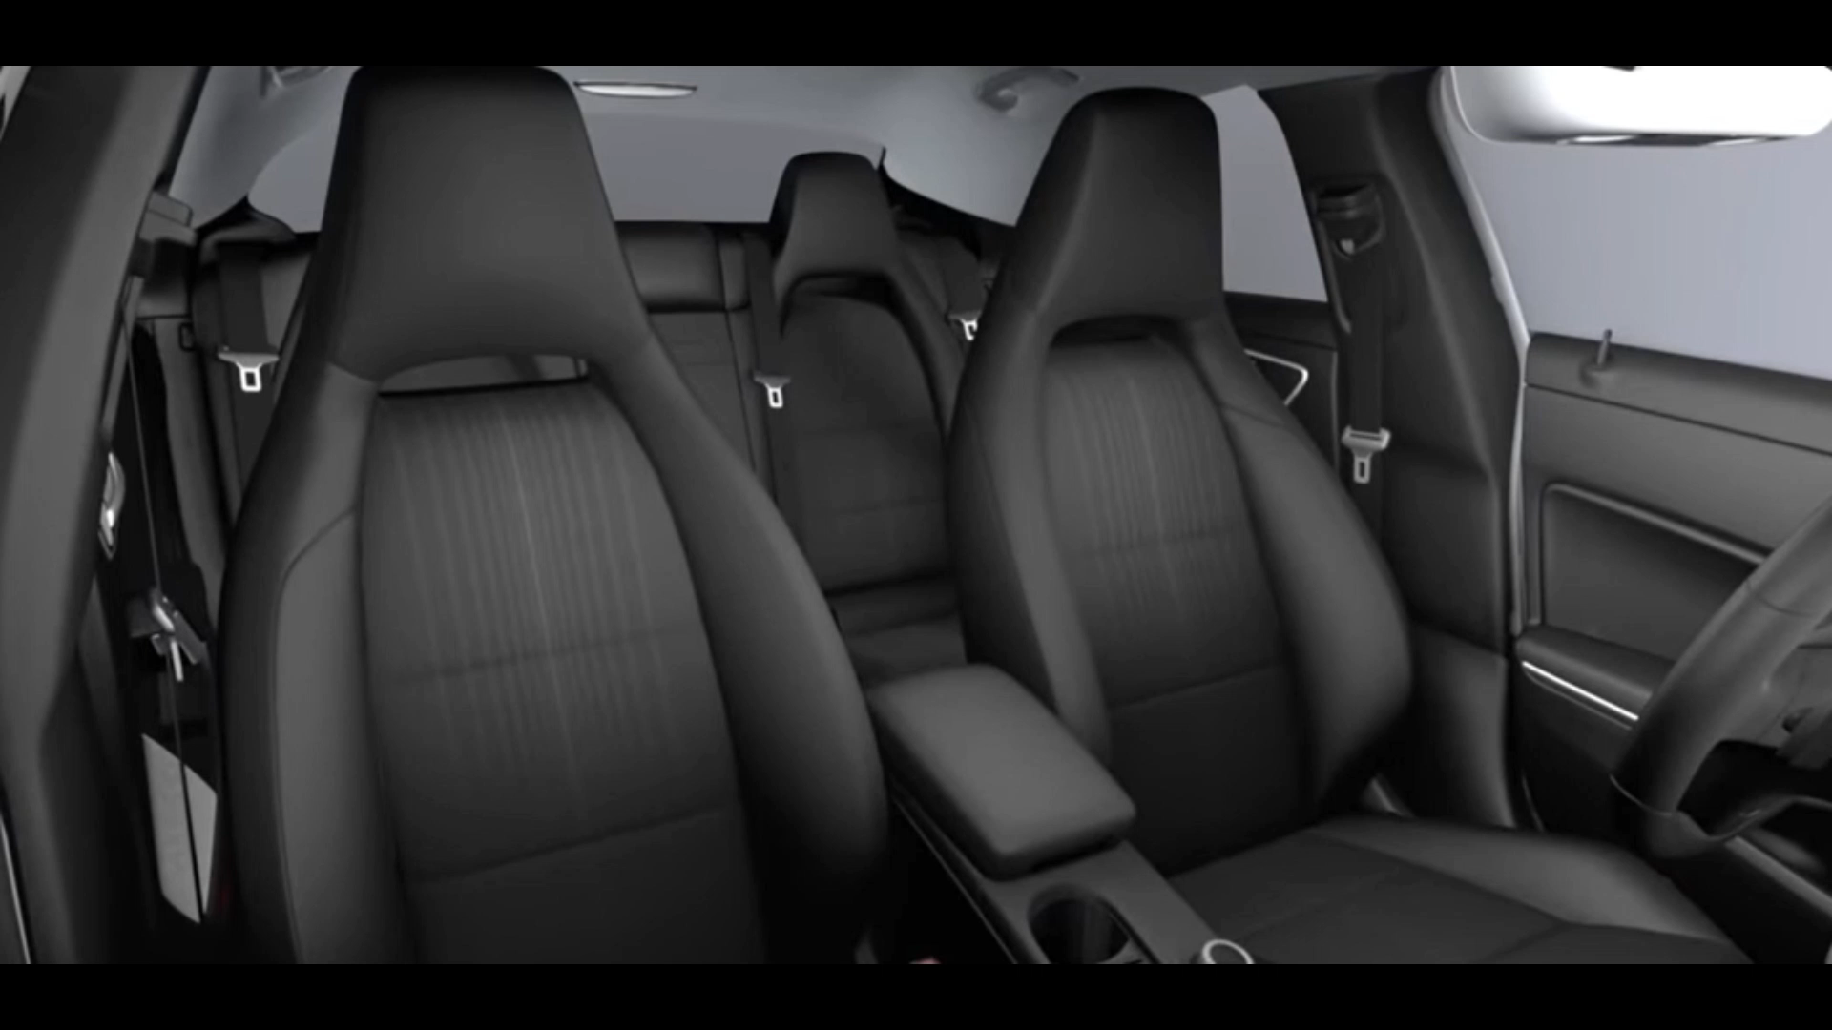
Personalize

Slide 11




Personalize

Slide 12
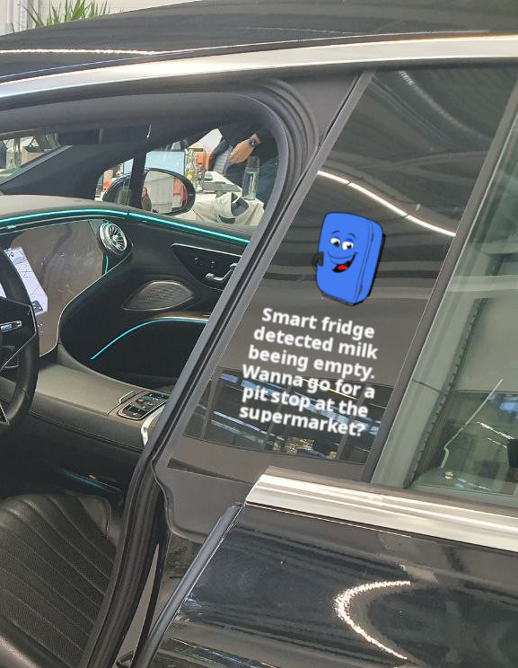
So Much More..
Integration with smart home devices for seamless transition from home to car.
Driver condition check.
Driver emotion matching.
Visually interactive body.

Slide 13
How do we scale?
Greeter
Friend
Companion
Automatic door open on unlock
Welcome song and cabin climate control
Face authentication on user profiles
Calendar sync for navigation
Seamless music transition
Driver driving capability check
Seamless integration with smart devices
Visually interactive B pillar display

Slide 14
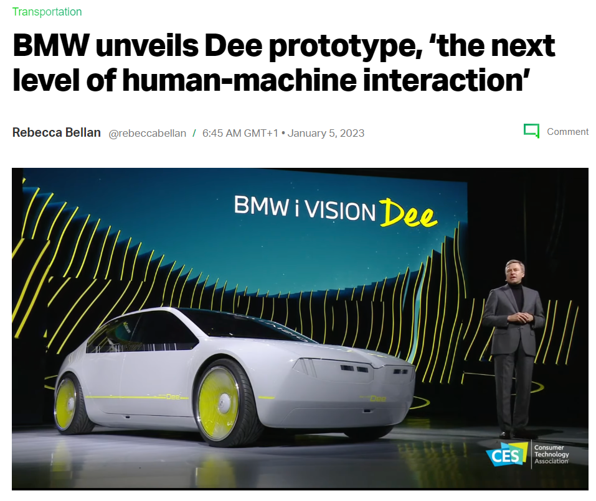
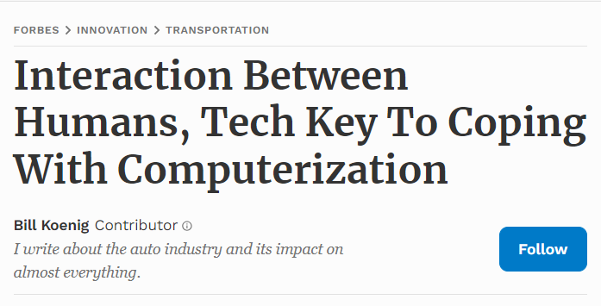
Our Development Journey
Phase 1: Understanding the needs
Key Points Queried:
Why do we need a greeter?
What can we expect from a greeter?
What can we add more?
Ideate and brainstorm!

Slide 15



Our Development Journey
Phase 2: Grouping the ideas.
Grouping the ideas as per:
Feature level
Configuration level
Implementation difficulty level
Greeter
Recognize
Personalize
Friend
Companion
Greet

Slide 16
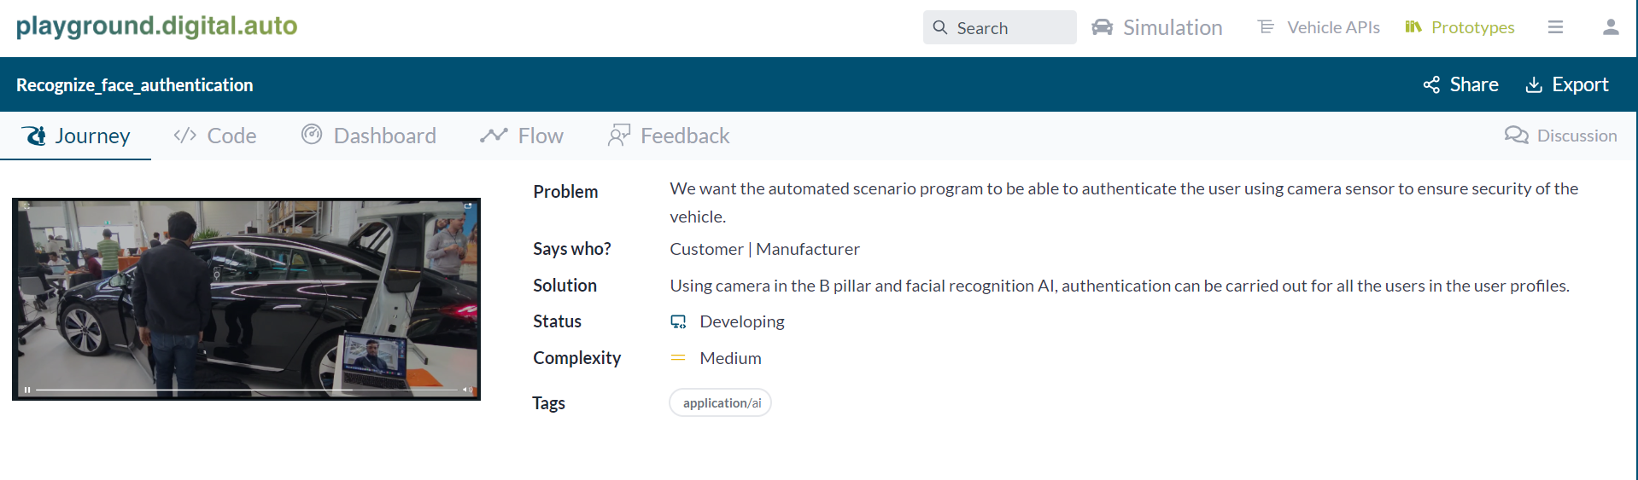
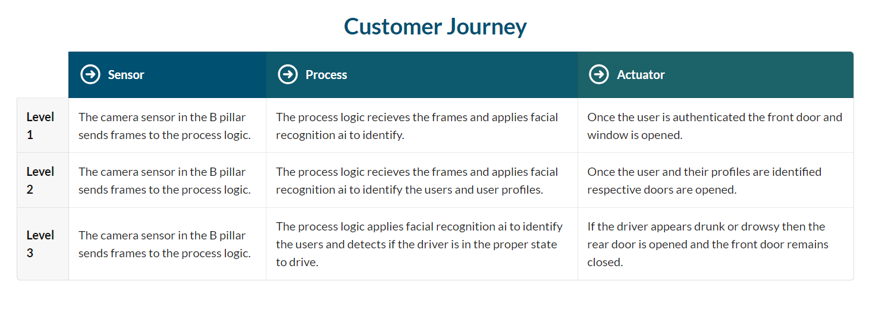
Our Development Journey
Phase 4: Working on the Recognize set of features.
Setting up the levels as per
configuration of vehicle.

Slide 17
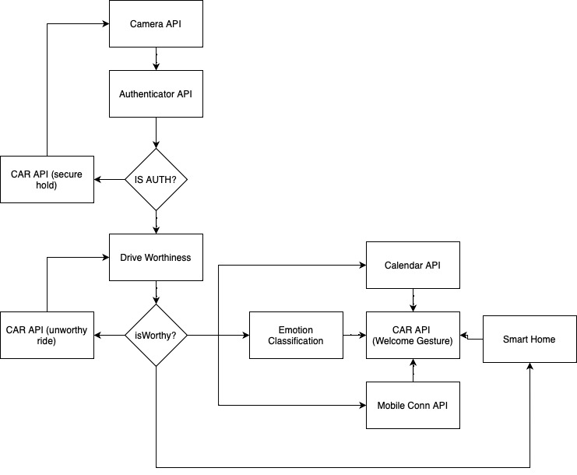
Our Development Journey
Phase 5: Codifying the logic
Phase 6: Implementation

Slide 18
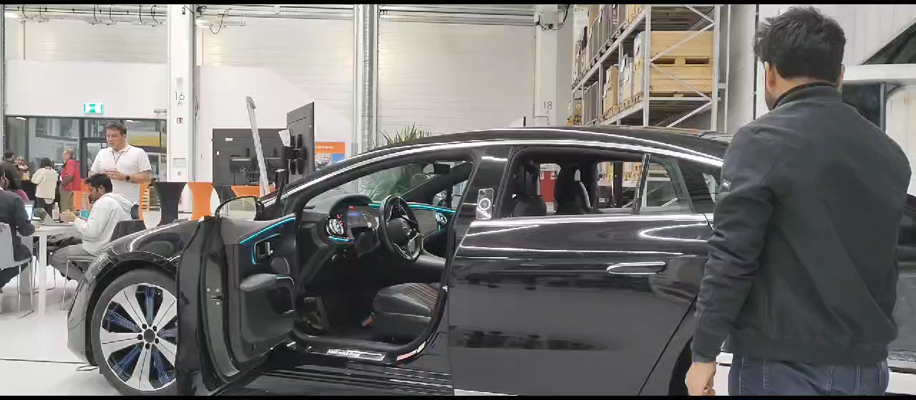
Implementation

Slide 19
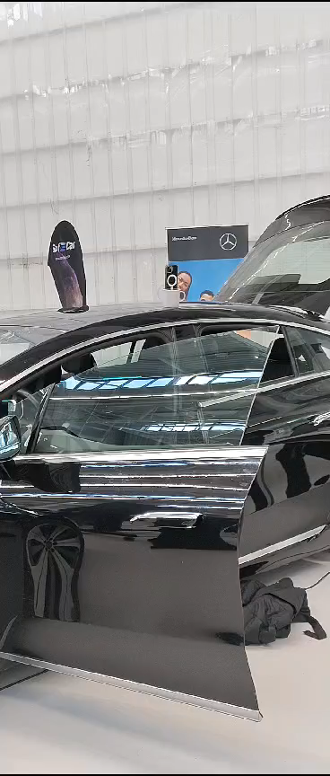
Implementation

Slide 20
Say Bye Greeta!
Connecting your car through Human Touch!

